Slide 1
PROJECT ID: 24CC3046-P019 | OPERATIONS TRACK
Azure Update Manager
Patch Compliance Programme
Enterprise Cloud Automation, Dynamic Patch Management, and Zero-Trust Compliance
Teams: T121
Programme Scope
2400032808 — Mule Aishwarya
2400032755 —M. Tanush Kumar
2400032851 — V.swapna grace
2400032938 — kantapureddy dinesh
60 Target Virtual Machines
Multi-region hybrid workloads
100% Patch Compliance Objective
Executive-level audit reporting

Slide 2





TEAM STRUCTURE
Team Roles & Operational Allocation
Team Composition
Key Responsibilities
3 collaborative student teams (T019, T121, T223) comprising 12 members across Operations. Roles are divided into:
Infrastructure Onboarding
VM scoping, tagging strategy, and dynamic ring configuration
Cloud Architecture
Maintenance Schedule Authoring
Patch Automation
Customer-managed schedule design with recurrence and reboot policies
Pre/Post-Patch Script Development
Compliance Reporting
Health validation, snapshot automation, and abort triggers
Risk Mitigation
KQL Workbook Configuration
Log Analytics workspace dashboards for executive compliance reporting

Slide 3





STRATEGIC ALIGNMENT
Project Overview & Core Objectives
Strategic enterprise initiative leveraging native Azure Update Manager for SaaS-based, agentless update management across cloud and hybrid VMs — eliminating WSUS/SCCM overhead with a control-plane-native approach.
100% Patch Compliance
Zero-Friction Automation
Achieve full patch compliance across all 60 target infrastructure nodes
Automate maintenance windows with zero manual intervention
Dependency Safeguards
Executive Reporting
Pre-patch health validation and snapshot restore points
Deliver KQL-powered compliance dashboards to leadership

Slide 4
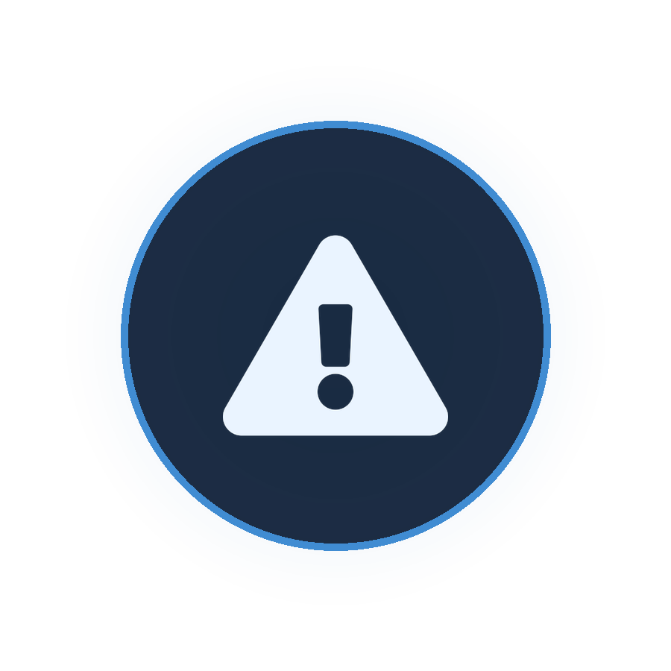



OPERATIONAL REQUIREMENTS
Problem Statement & Real-World Use Cases
Legacy Challenges
Core Real-World Use Cases
Manual Overhead
1
Patch 60 Virtual Machines
Patch administration requires significant human intervention across 60+ nodes
Dedicated maintenance schedules per patch ring across Windows and Linux workloads
2
Executive Compliance Reporting
Inconsistent Baselines
Report compliance metrics via KQL workbooks directly to management stakeholders
Uneven patch postures creating exploitable security vulnerabilities
3
Zero-Day Vulnerability Remediation
Unplanned Reboots
Rapid patching across multi-region workloads with critical classification targeting
Downtime during business hours impacting production workloads
Slow Compliance Audits
Manual reporting delays preventing timely executive visibility

Slide 5
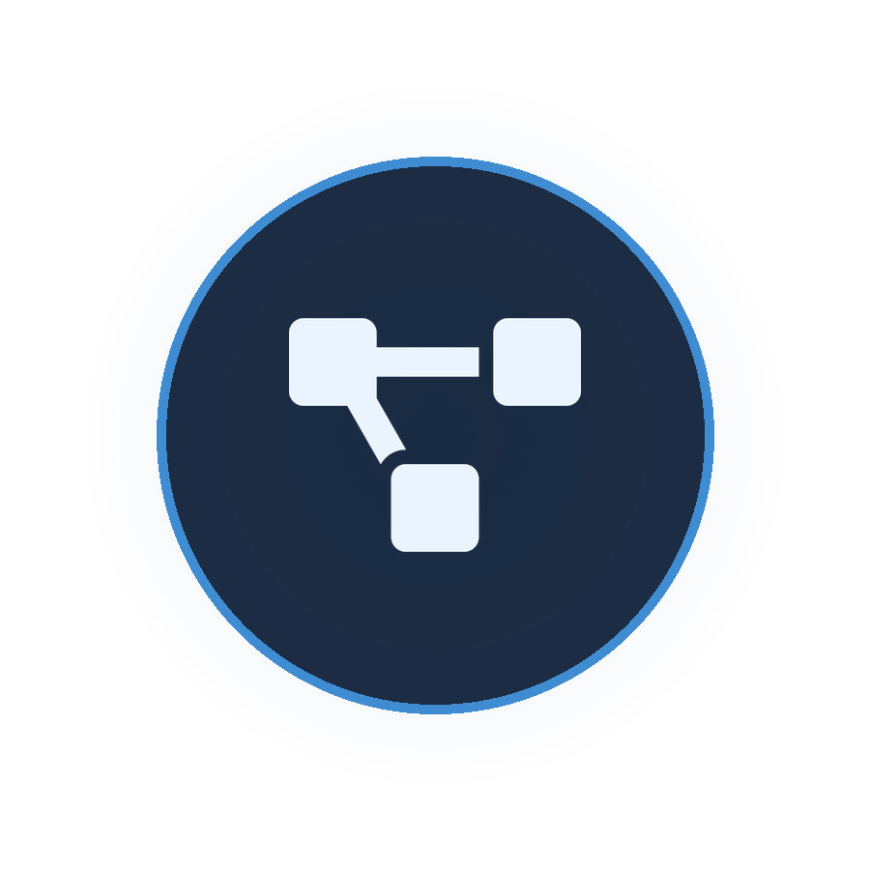




TECHNICAL BLUEPRINT
Azure Services & Solution Architecture
Key Azure Services
Solution Architecture Flow
Azure Update Manager
Azure Policy Assessment
Native SaaS control plane — agentless update orchestration
Triggers 24-hour periodic assessment across all scoped VMs
Azure Virtual Machines
Dynamic Tag Grouping
60 target nodes (Windows & Linux) across multi-region rings
Tags group 60 VMs into patch rings (Env: Prod | PatchRing: Weekend)
Azure Policy
Maintenance Execution
Governance engine for 24-hour periodic assessment scanning
Maintenance Configurations execute scheduled update deployments
Log Analytics & Monitor
Telemetry & Reporting
KQL workbooks for telemetry, audit logging, and executive dashboards
Audit logs stream to Log Analytics for executive compliance reporting

Slide 6
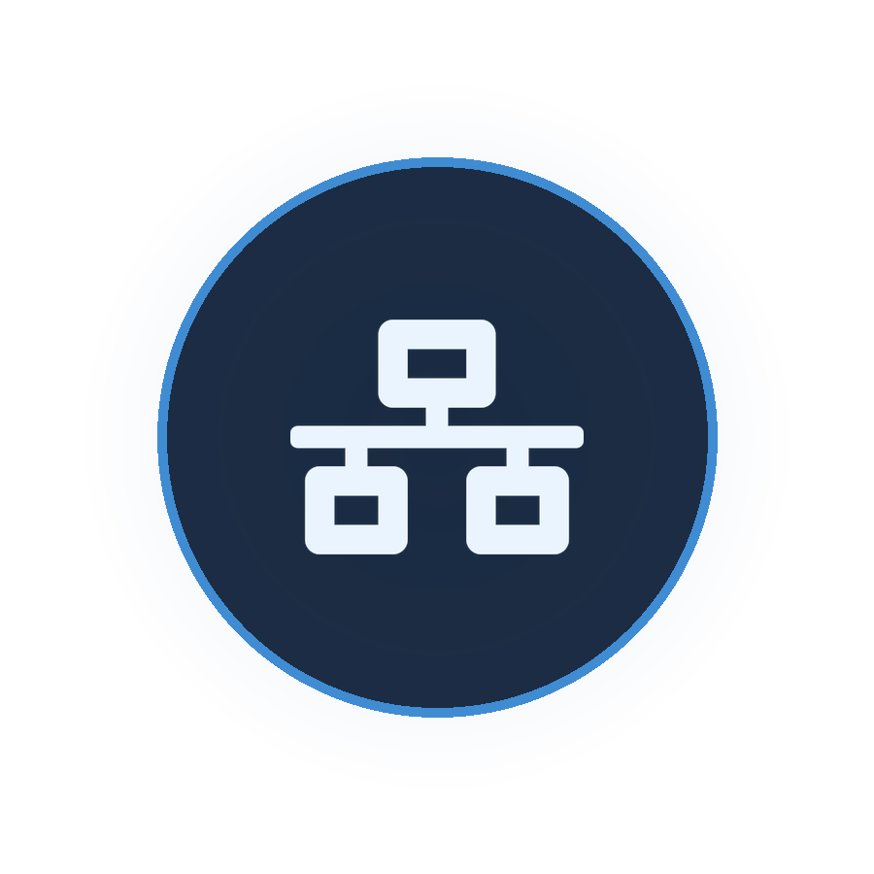



INFRASTRUCTURE CONFIGURATION
Azure Resource Setup & Networking
Resource Configuration
Networking & Security
60 target Windows/Linux VMs scoped using dynamic tags:
Outbound HTTPS (443)
Env Tag
Connectivity to Azure Update Manager service endpoints
Prod
Private Endpoints
PatchRing Tag
Secure Log Analytics log ingestion without public exposure
Weekend
Schedule Type
NSG Restrictions
Customer Managed
Network Security Group rules limiting lateral traffic
Assessment
Global Periodic
Zero Public IP
No public IP exposure required for patch management operations

Slide 7
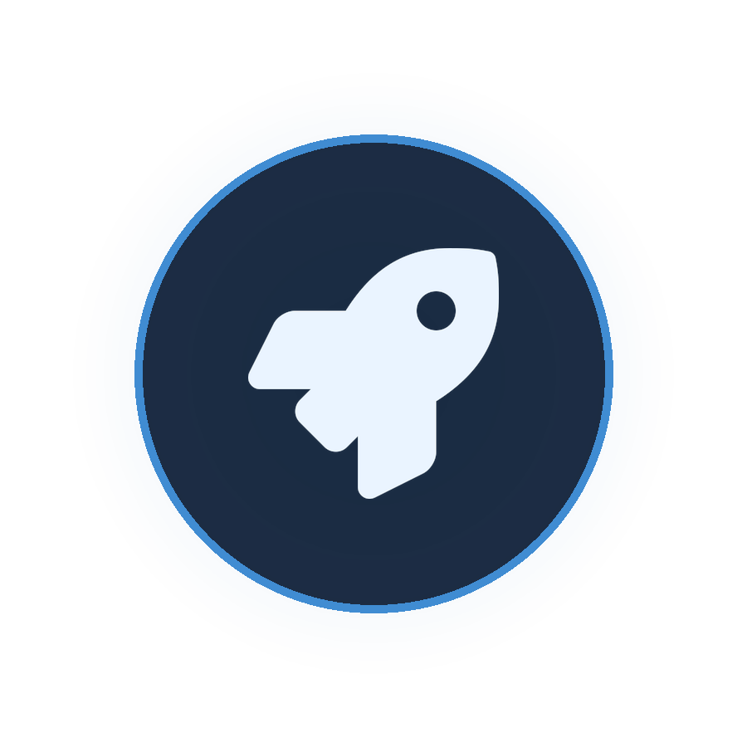





EXECUTION METHODOLOGY
Implementation Approach & Deployment Strategy
Phased Deployment Approach
Discovery & Baseline
Dynamic Tagging & Scoping
Schedule Authoring
Pre/Post Script Hooks
Full Fleet Onboarding
Deployment Parameters
Schedule
Maintenance Window
Reboot Policy
Monthly — 3rd Sunday at 02:00 UTC
3-hour maximum duration
RebootIfRequired
Patch Classification
Critical & Security updates only

Slide 8






GOVERNANCE FRAMEWORK
Security, Governance & Storage Setup
Access Management (RBAC)
Storage & Retention Configuration
Log Analytics Repository
Immutable Archive Storage
Update Manager Contributor
90-day active retention for real-time compliance reporting and KQL dashboards
365-day archived immutable logs for regulatory and audit compliance
Assigned to operations leads for patch orchestration and schedule management
Data Collection Rules (DCRs)
Compliance Reader
Applied to all 60 VMs to optimize log ingestion costs and filter telemetry
Assigned to management and audit teams for read-only reporting access
System-Assigned Managed Identities
Passwordless authentication for automation runbooks — zero stored credentials

Slide 9



OPERATIONAL SAFETY & SAFEGUARDS
Monitoring, Validation & Performance Results
Bottleneck Mitigations
Key Performance Results
Application Dependency Risk
100%
Mitigated via pre-patch health validation scripts and automated VM restore point/snapshot creation before execution
Patch Compliance
Business-Hour Reboot Conflicts
Across all 60 target VMs
Mitigated using off-peak timezone-aware maintenance windows and reboot suppression flags on mission-critical nodes
0
Testing & Staged Rollout
Unplanned Outages
Dev → Staging → Prod pipeline with post-patch HTTP health checks; alert rules fire incident tickets if failure exceeds 5%
Zero service disruptions
80%
Effort Reduction
Decrease in manual patching effort
35%
Cost Savings
Reduction in log ingestion via targeted DCRs
Cost Optimization: $0 native platform overhead for Azure VMs. Zero dedicated WSUS/SCCM management server infrastructure costs eliminated.

Slide 10



RETROSPECTIVE & CLOSING
Lessons Learned, Roadmap & Live Demo
Lessons Learned
Future Roadmap
Live Demo & Conclusion
Dynamic Tag Scaling
Azure Arc Integration
Tag-based scoping scales far better than static VM lists for large fleets
Onboard on-premises servers via Azure Arc for unified hybrid patch management
Portal Walkthrough
Azure Update Manager UI and 60 VM compliance dashboard review
Fail-Safe Scripts
AI-Driven Patch Windows
Pre-patch scripts require robust abort triggers to prevent cascading failures
ML models for optimal patch window prediction based on workload patterns
Schedule Execution Demo
Proactive Communication
CI/CD Compliance Gates
Live maintenance schedule execution and reboot policy validation
Schedule communication to application owners is essential for zero-conflict patching
Embed patch compliance gates into Azure DevOps pipelines for shift-left security
KQL Compliance Report
Workbook-generated executive compliance report generation
Conclusion: Successfully automated OS patch management for 60 VMs with zero business disruption and complete audit compliance.
Q&A: Open floor for questions and technical discussion.

